Slide 1
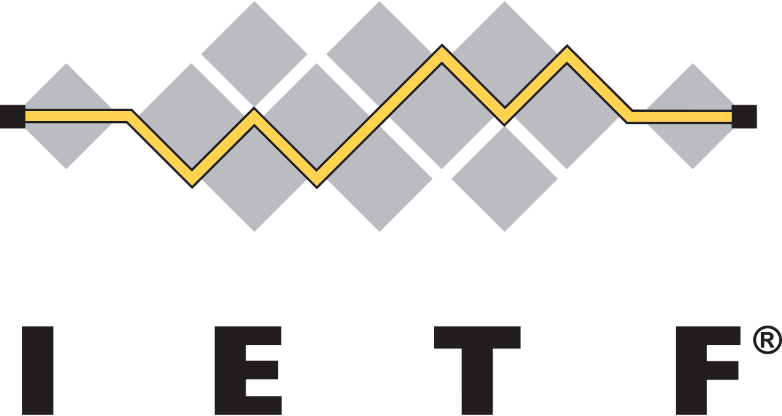
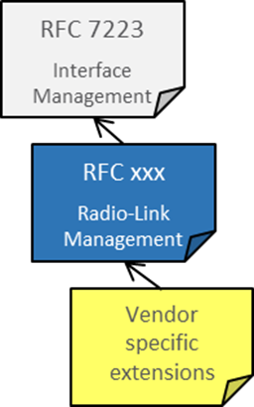
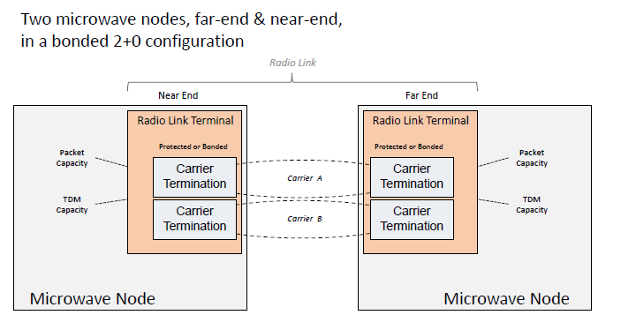
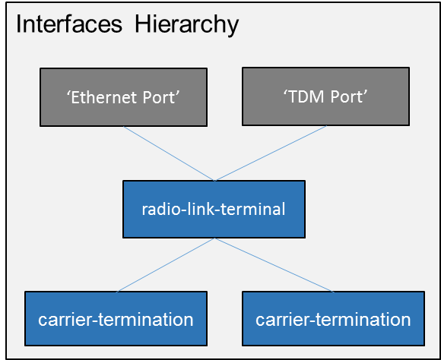
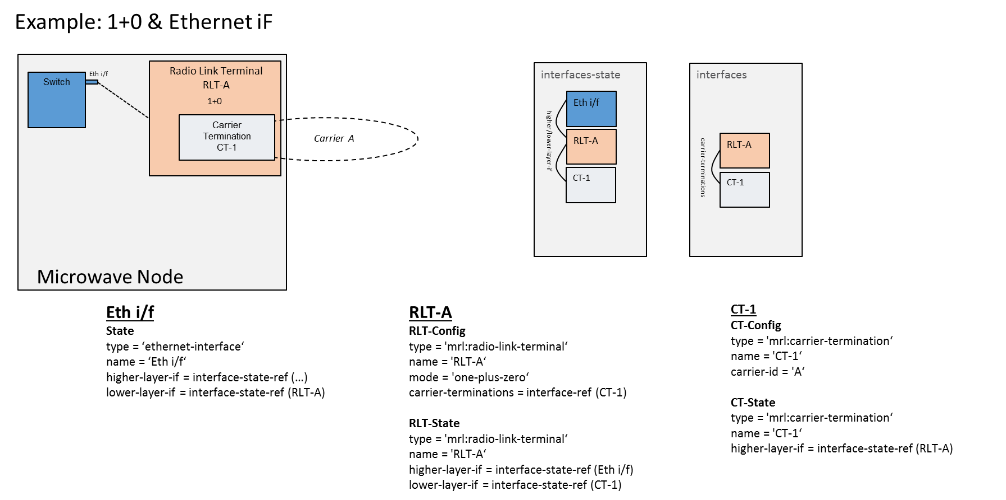
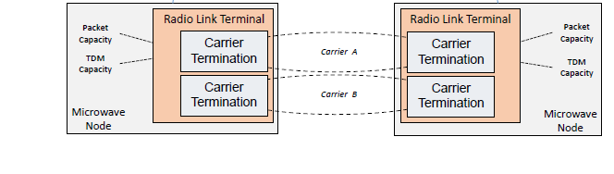
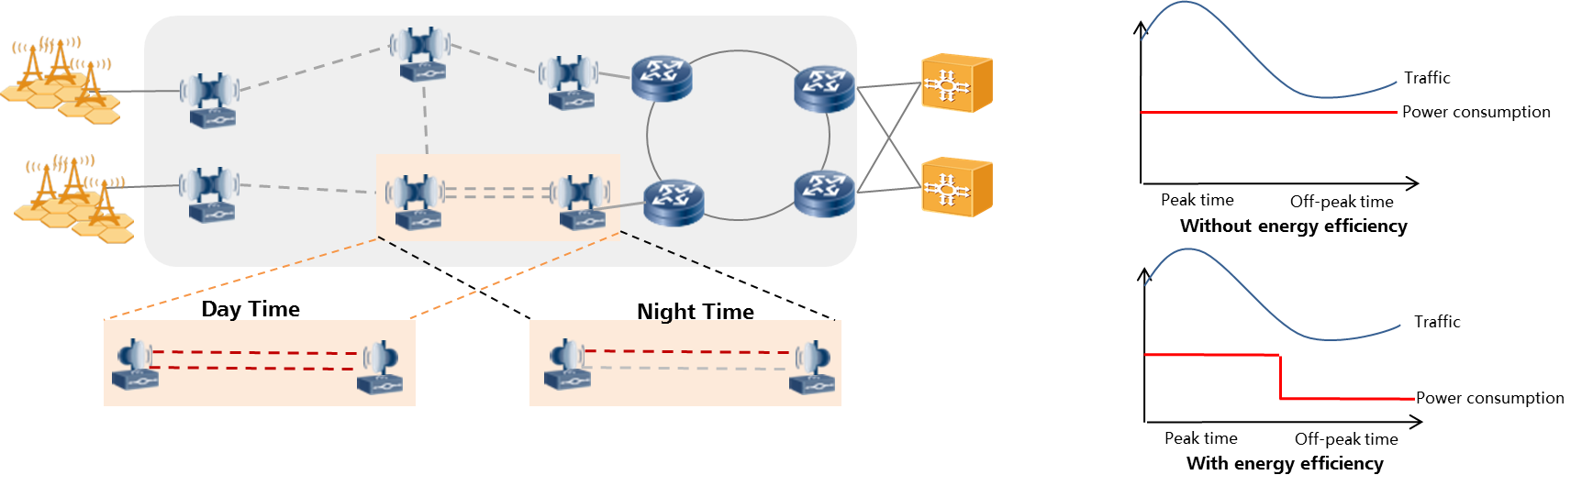
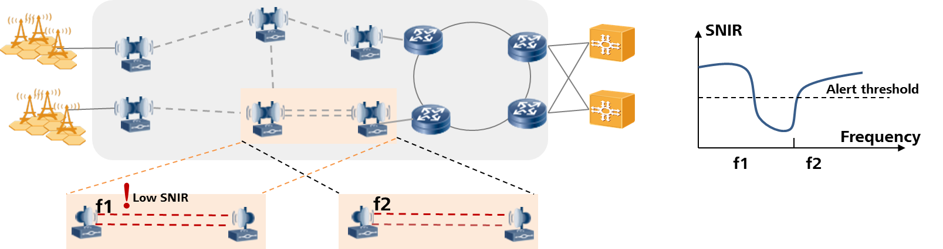
A YANG Data Model for Microwave Radio Link
Introduction
YANG Data Model
RLT (Radio link termination)- config/state
CT (Carrier termination) - config/state
Protection - config/state
XPIC(Cross Polarization Interference Cancellation) – config
MIMO (Multiple-Input Multiple-Output)- config
Designed a YANG data model to control and manage the radio link interfaces and the connectivity to packet and/or TDM interfaces in a microwave/millimeter wave node.
It augments RFC 7223 to align with the same structure for management of the packet interfaces.
Hackathon Setup
App 1:
Energy efficiency
App 2:
Dynamic frequency control
Two applications to be developed in Hackathon:
App 1: Energy Efficiency
App 2: Dynamic frequency control
Controller: ODL Boron-sr3
Implementation of MW YANG model in ODL controller in advance
Radio link: simulating one hop with “2+0” configuration
MW YANG
model
SDN controller – ODL based
draft-ietf-ccamp-mw-yang
Use Case 1: Energy Efficiency
Goal: to save power when traffic is low
Manually setting: in day time, set tx-enable of carrier B to TRUE; in the night set tx-enable of carrier B to FALSE
Time period may also be set: 8:00 – 24:00, tx-enable = TURE; 0:00 – 8:00, tx-enable = False
Use Case 2: Dynamic frequency control
Goal: to control the interference
Poll the SNIR from the node
The controller compares the value with a predefined threshold
If the value is lower than threshold, the controller will
- Decide a new frequency for the link
- Disable the tx/rx
- Set the new tx-frequency/rx-frequency
- Enable the tx/rx
ERICSSON, HUAWEI, NEC, NOKIA, AVIAT NETWORKS

